Slide 1
VSW Project Kickoff
October 6, 2020
Futurewei Technologies, Inc.
Wenjing.chu@futurewei.com

Slide 2
Table of Content
Team Introduction
Background Information, Overall Motivations and Goals
Scope (SOW)
High Level Design
Development and Test Environment
Milestones and Acceptance Criteria
Communications
Q&A

Slide 3
Team Introduction
Personal introduction
Name
Brief background
Your role and responsibility in this project
(optional) Anything you like about this project

Slide 4
Background (Motivation)
Modern software supply chain is very complex
It makes software vulnerable from security and trust perspective.
Programmers have difficulty find good quality trustworthy software components.
It makes software dependencies difficult to understand and maintain.
VSW proposes to solve this challenge by enabling a new type of ecosystem with trustworthy information exchange between parties.
It's a decentralized ecosystem.
It's a set of tools and services that enables such an ecosystem
VSW is designed to be universal and broadly reusable for any digital assets. For this SOW purposes, the initial scope of focus is
Open source software ecosystem

Slide 5

Motivating Example 1
(Reuters) — A newly discovered spyware effort attacked users through 32 million downloads of extensions to Google’s market-leading Chrome web browser, researchers at Awake Security told Reuters, highlighting the tech industry’s failure to protect browsers as they are used more for email, payroll, and other sensitive functions.
It is unclear who was behind the effort to distribute the malware. Awake said the developers supplied fake contact information when they submitted the extensions to Google.
The extensions were designed to avoid detection by antivirus companies or security software that evaluates the reputations of web domains.
Malicious developers have been using Google’s Chrome Store as a conduit for a long time. After one in 10 submissions was deemed malicious, Google said in 2018 it would improve security, in part by increasing human review.
Threat model:
Fake developer identity
Avoid reputation of web domain based detection
Avoid human review based detection

Slide 6

Motivating Example 2
The 39 affected apps—which included version 6.2.5 of the popular WeChat for iOS, CamScanner, and Chinese versions of Angry Birds 2—may have been downloaded by hundreds of millions of iPhone and iPad users. The programs were infected by a tampered version of Apple's app development tool called Xcode. A repackaged tool, called XcodeGhost, surreptitiously inserted malicious code alongside normal app functions that caused the app to report to a command and control server.
Threat model:
Unauthentic software tool
Software tool injected malicious code (authentic developer who are not aware)

Slide 7


Motivating Example 3
“With free software, anyone can inspect the source code for malicious flaws. But Debian provide binary packages to its users. The idea of “deterministic” or “reproducible” builds is to empower anyone to verify that no flaws have been introduced during the build process by reproducing byte-for-byte identical binary packages from a given source. ”
Challenge:
It is extremely difficult to trace software from source code tree to a final executable (provenance).
It is difficult to understand dependencies.
The Telegram instant-messaging platform announced that they had updated their iOS and Android OS applications and claim that they are reproducible according to their full instructions, verifying that its original source code is exactly the same code that is used to build the versions available on the Apple App Store and Google Play distribution platforms respectfully.
These are just some of the examples, not exhaustive.

Slide 8
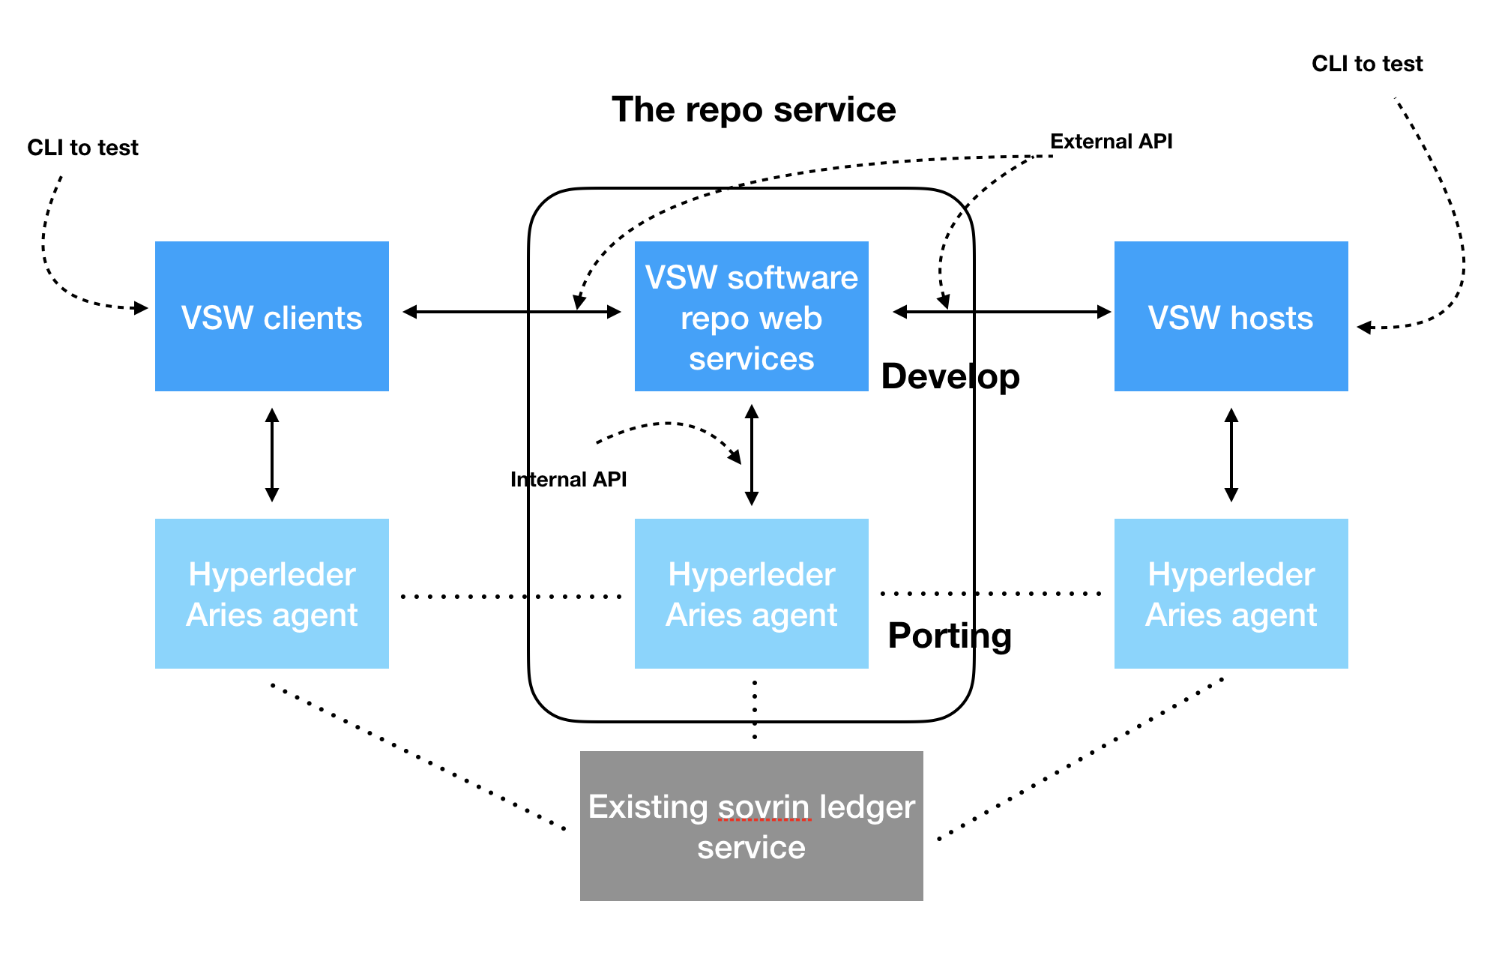
Scope for the SOW
The scope of the SOW includes
establishing a development and test environment on Linux based systems (with deployment on AWS).
developing the two software components (i) Aries agent and (ii) Repo service in staged fashion, integrated and tested, documented. (See diagram on the right)
FW will provide detailed modification requirements for (i), and the API spec for (ii), including overall design for (ii) for software tool and middleware choices. FW will provide a set of acceptance test cases as well to further delineate functionality, reliability and performance expectations.
All deliverables are to be submitted to Futurewei via Github. In addition to Github based tools, we will have short daily Zoom meetings and extended weekly Zoom meetings to coordinate work between project members.

Slide 9
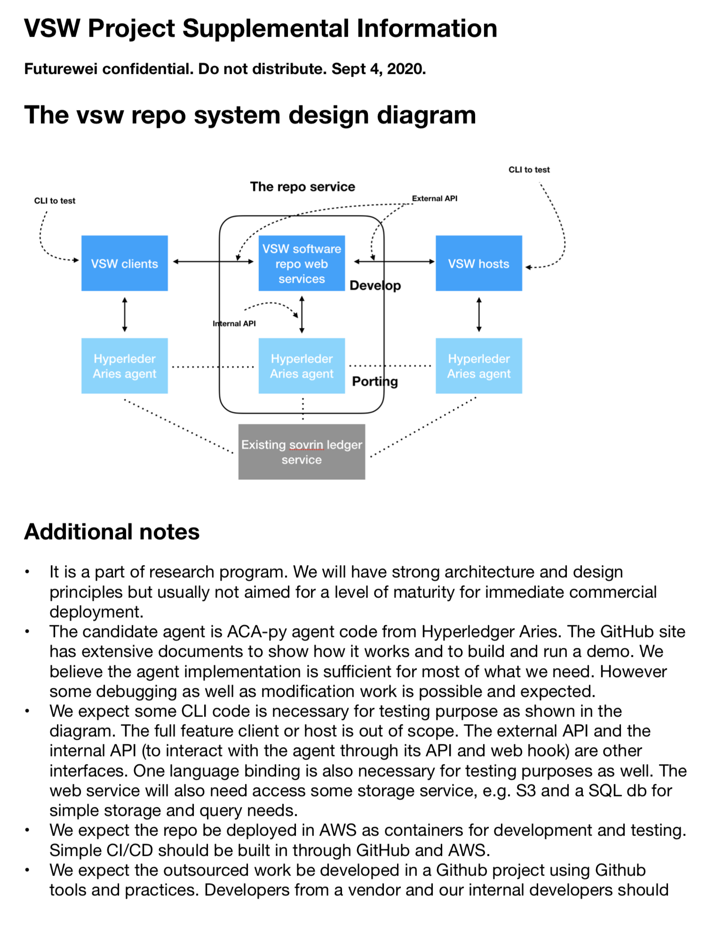
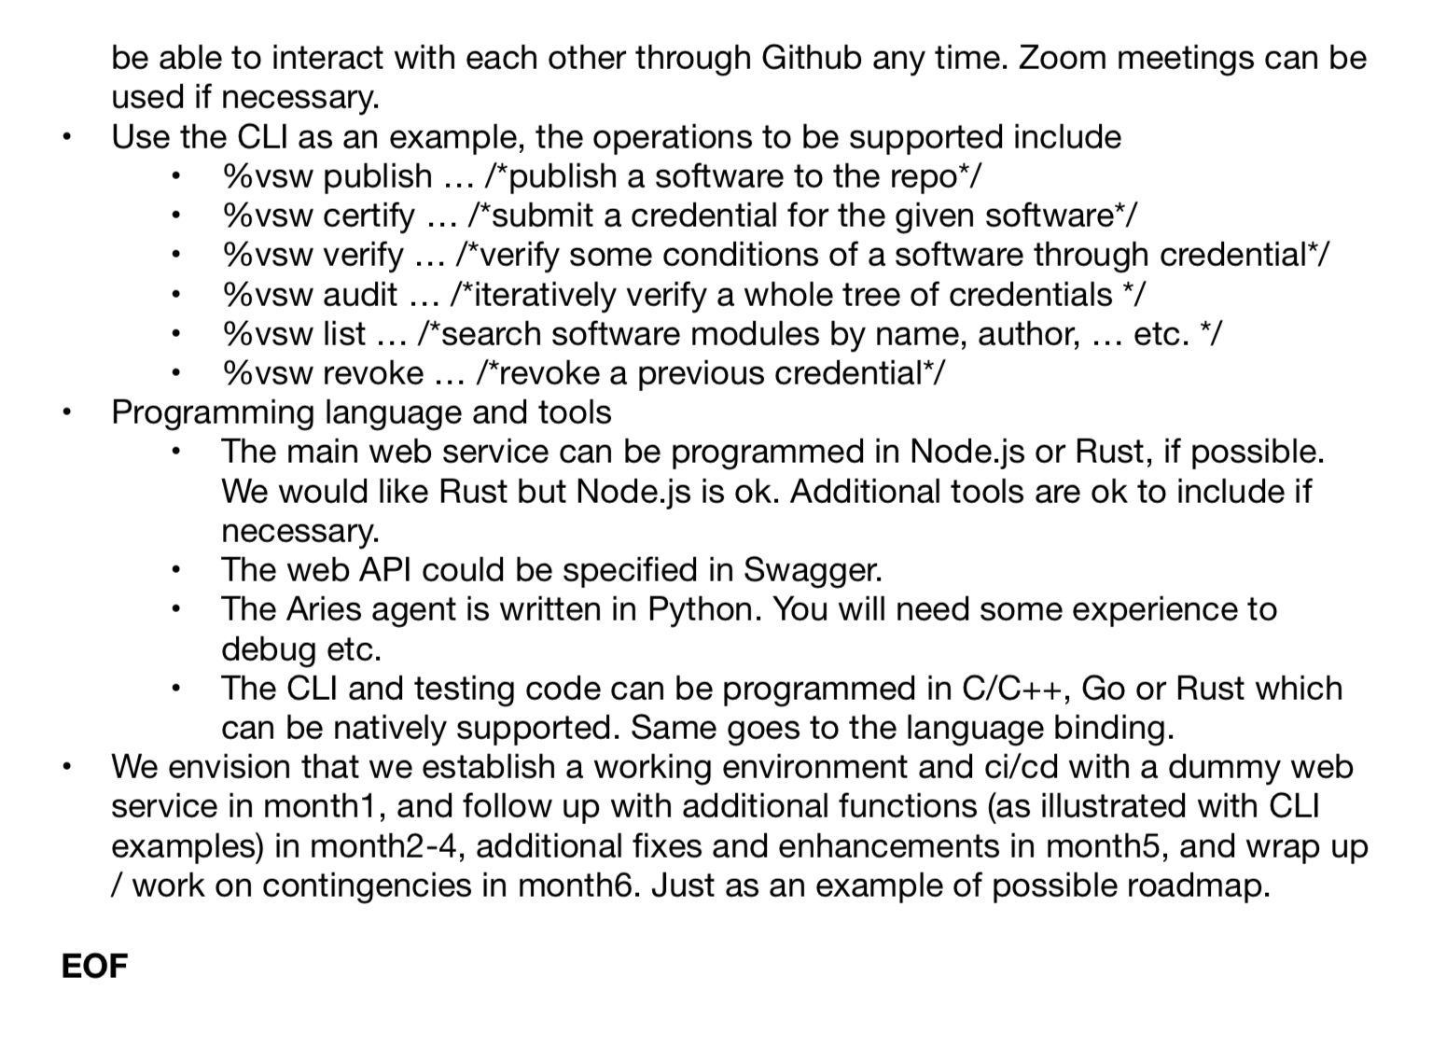
These are high level descriptions and being actively revised. Definitive spec and reqs should be based on: https://github.com/verifiablesoftware/vsw

Slide 10
Dev and Test Environment
VSW will use automated CI/CD from Github to AWS.
Futurewei will provide spec for requirements
Symbios will develop the continuous deployment and testing pipeline based on Github and AWS
Use standard containers to reduce / remove tight dependency on AWS (we want to be able to deploy to Azure, GCP, …). Use cloud native design (keep it stateless for scaling in future).
Futurewei will provide cloud resources. All local machines: use your own. Clients should support native (Linux, MacOS), servers can be docker containers, e.g.
Cli clients, browser/curl clients on local machines
github/verifiablesoftware/vsw
Commit triggers ci/cd script to build, deploy, test
Containers (on public cloud, or docker@local for unit test)

Slide 11
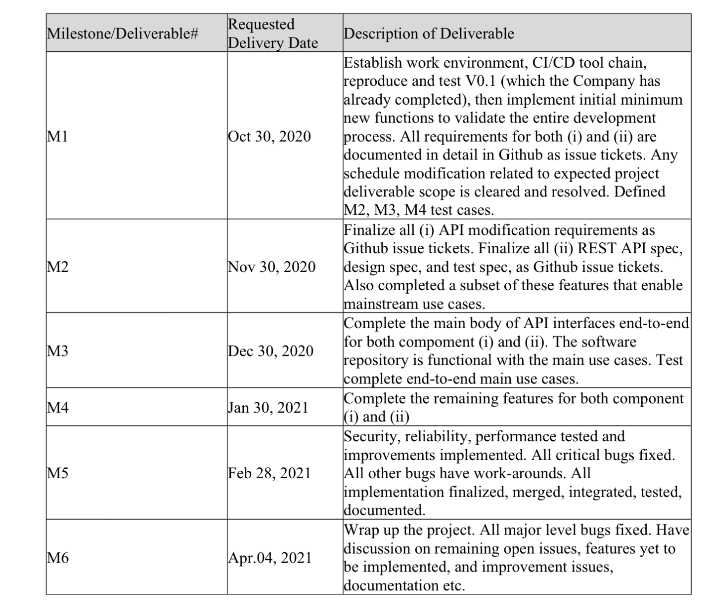
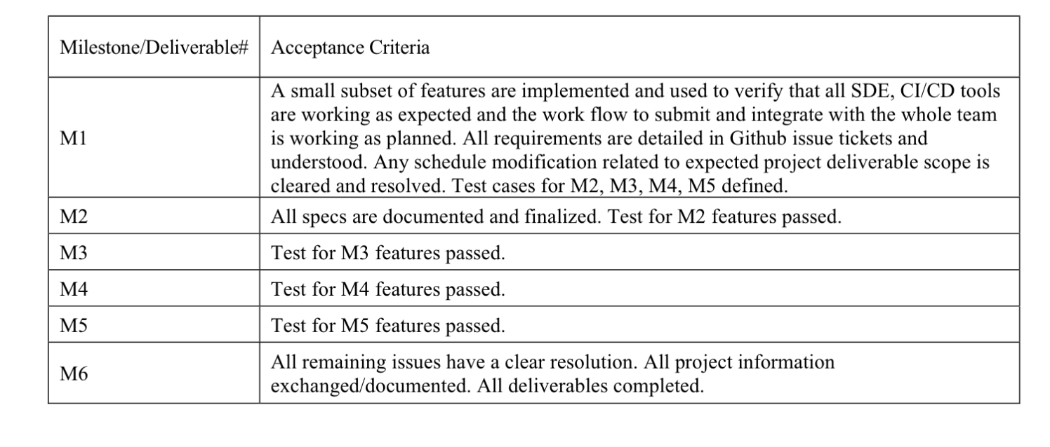
Milestones and Acceptance Criteria
Define a list of Github issues and test suites for each milestone
https://github.com/verifiablesoftware/vsw​

Slide 12
Communications
Github: https://github.com/verifiablesoftware/vsw
All discussions about technical specs, functions, issues, bugs...
Slack:
All informal IM needs – not archived, not for deliverables. Quick interactions and daily sync-ups.
Any substantive technical content must use Github.
Zoom:
Regular video meetings for real-time sync up and issue resolution. Weekly Issue scrub.
Regular Zoom meeting time

Slide 13
A few additional words
Welcome
It's an R&D project. We welcome your inputs if you see things that can be improved.
A note on EC

Slide 14
Q&A

